Slide 1
Proton Plan
Cost and Schedule Report
Ken Domann

Slide 2
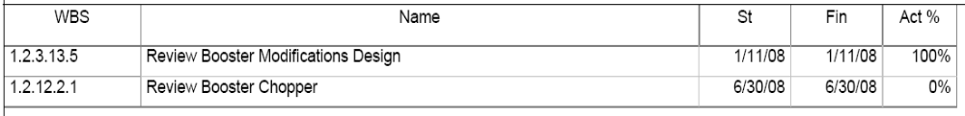
Project Reviews – 1 year Window
Notes:
Booster chopper schedule needs re-plan, B Pellico given reports, awaiting input.

Slide 3
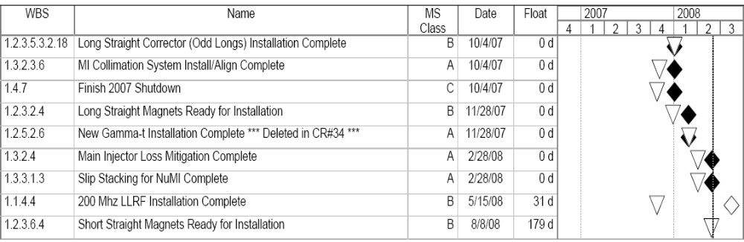
Milestones – 1 Year Window
Float values based on new shutdown dates of
4/6/09 – 6/12/09
Legend
Forecast Date –
Complete Date-
Baseline Date -

Slide 4
Critical Path
6 Month time window, <10 days of float
No activities satisfy critical path criteria with new shutdown dates
Shutdown currently scheduled for 4/06/09 – 06/12/09

Slide 5
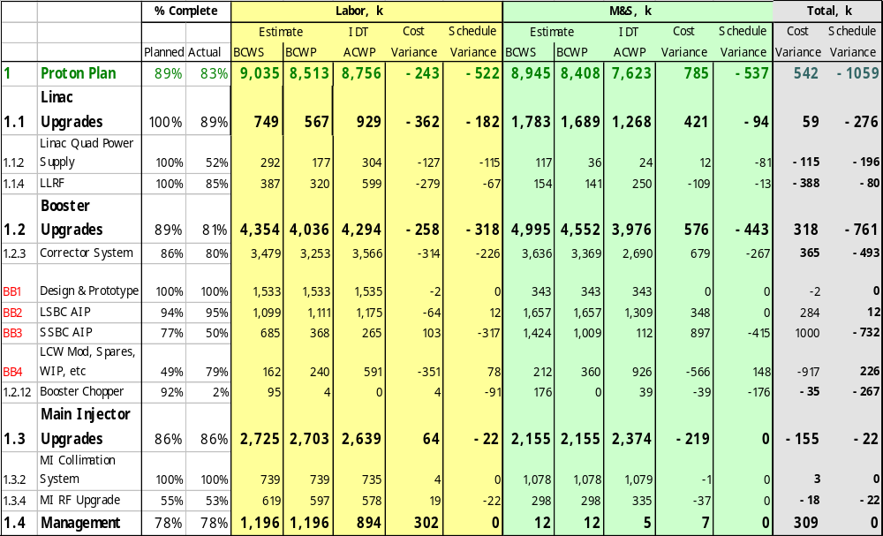
Earned Value
Need CR
Note: 100% complete tasks not shown

Slide 6
Earned Value Analysis
Linac Quad PS & LLRF
  Progress is slower than the plan – need re-plan (CR)
Corrector System Design & Prototype 100% complete
  CR to retire cost variances prepared and approved.
Booster Chopper – needs re-plan
MI Collimation labor cost overrun
  CR processed and approved to retire cost variances
MI RF Upgrade CV and SV – CR ready for signature

Slide 7
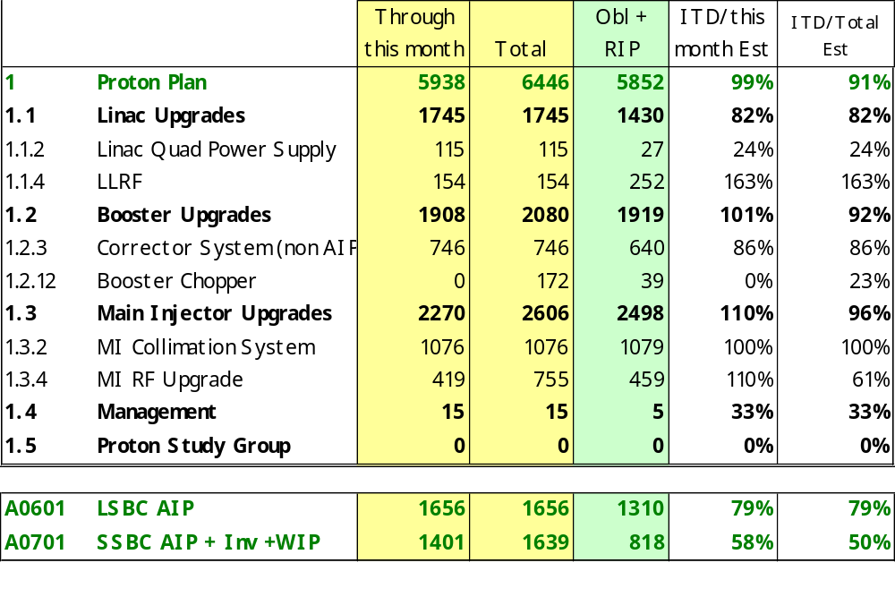
M&S Cost Performance
Late $486k PS fabrication contracts
Late $66k misc cable procurements
Notes: 100% complete tasks not shown

Slide 8
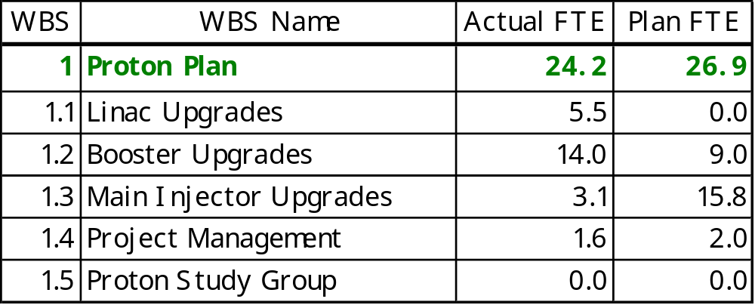
Effort

Slide 9
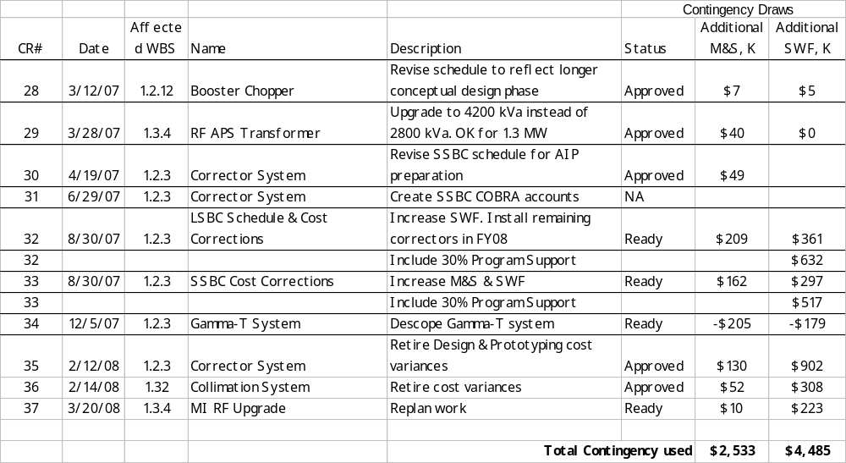
Change Request Log

